Slide 1

Vision
To be the area’s leading resource and recognized champion of matters related to quality.
Mission
To serve the needs of our membership and the community by providing a local forum for information exchange, professional support and continuous learning.
Web Page: www.asqfortworth.org
Notes:
1

Slide 2
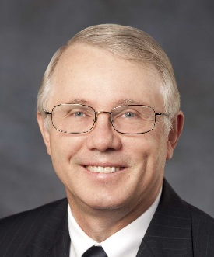
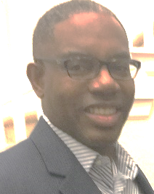

New Member Orientation - Agenda
About ASQ
About Us – Section 1416
  Leadership Committee Functions
  Dinner PD Meetings – Programs & Tutorials
  Certifications
  Education – Conference
  Local Opportunities
Communications – Personal Information
  Email Distribution
  Web Page www.asqfortworth.org

Slide 3
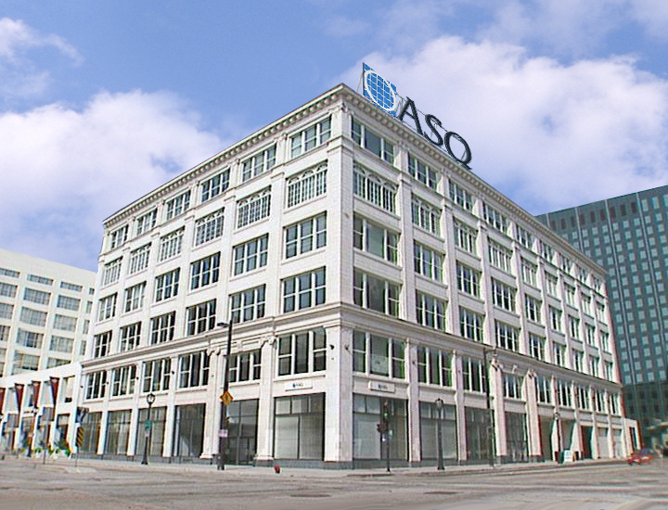
American Society for Quality
About ASQ
Resources
Certifications
Notes:
Thank you for volunteering some of your time to allow me to detail some of the ways in which ASQ is bringing the quality community together and leading the global quality movement.

Slide 4
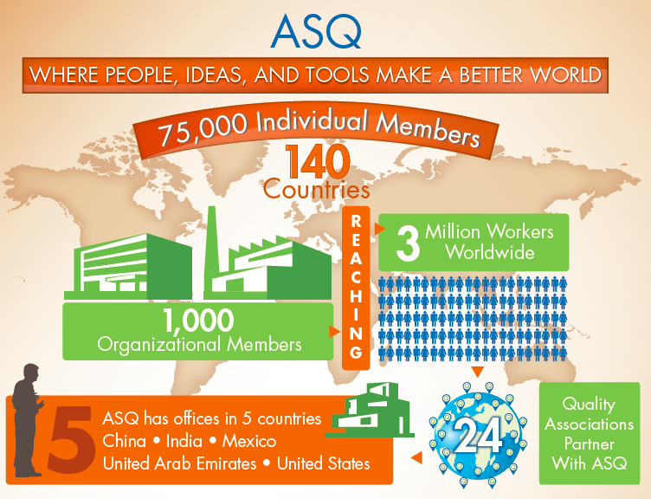
ASQ
Notes:
ASQ is a very different organization than we were even 5 years ago.
We now represent 75,000 individual members spanning 140 countries
With nearly 1,000 organization members we have been expanding our strategy to include serving the needs of organizations.
With offices in five countries, including the U.S., and 24 partnerships with quality organizations around the world we have significantly expanded our global footprint.

Slide 5
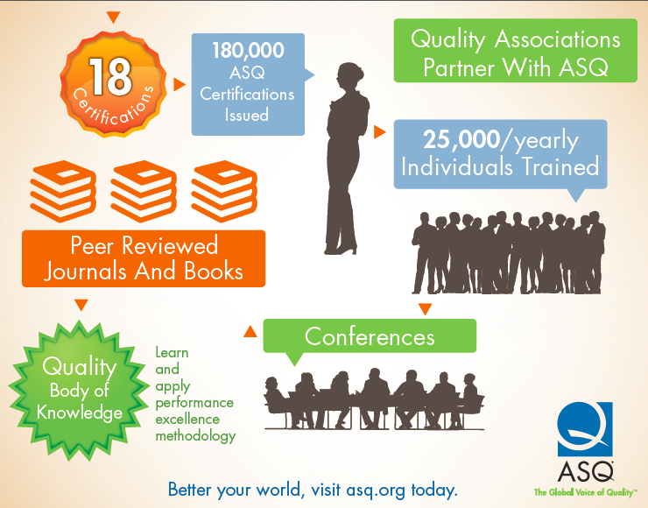
ASQ (continued)
Notes:
ASQ offers 18 certifications and has issued over 180,000 certifications worldwide.
On average we train 25,000 professionals each year.
From ASQ’s Quality Body of Knowledge to conferences to training and certification ASQ is helping our members and customers succeed in an ever-increasingly competitive environment.

Slide 6
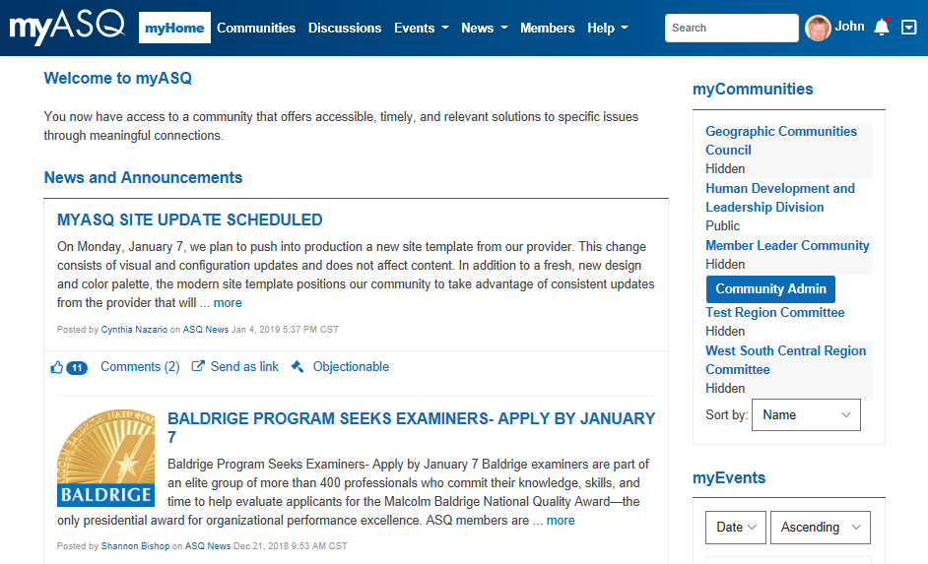
myASQ.org: Personal Portal
Events
Networking
Discussions
Communities
demo use at end
Notes:
ASQ offers off-the-shelf and customized training, anywhere in the world, with expert quality practitioners from across a range of industries and experiences and courses designed with every learning style in mind. From courses focused on compliance to best practices, ASQ offers the training experiences that let organizations and individuals gain and apply the knowledge to do more and get a competitive advantage.
ASQ’s Learning Institute equips corporations and organizations with a trusted, comprehensive resource to plan, assess, and execute the quality learning they need to realize their full potential as quality practitioners.
What makes ASQ training different?
ASQ’s training is created by instructional designers/developers and industry experts; then it’s peer-reviewed to achieve the highest level of
accuracy and relevance. Courses are taught by industry experts with an average of 25 years of on-the-job and teaching experience.
ASQ’s subject-matter experts who exhibit the highest level of expertise in their respective disciplines create the course content and develop the training materials.
No matter where your business is located in the world, ASQ can deliver training solutions right to your location.
ASQ’s new Quality Tools/“PDSA & QTools” (pictured here in the slide) are web-based learning products designed to be highly interactive and state of the art self-paced to accelerate learning. PDSA teaches individuals how to apply the tools in each step of the problem solving cycle. The products are designed for companies to deploy across their organization to ensure a common language and process is being used by all. These tools provide a working knowledge for all employees regardless of position –from the novice all the way to a refresher for senior members of a team.

Slide 7
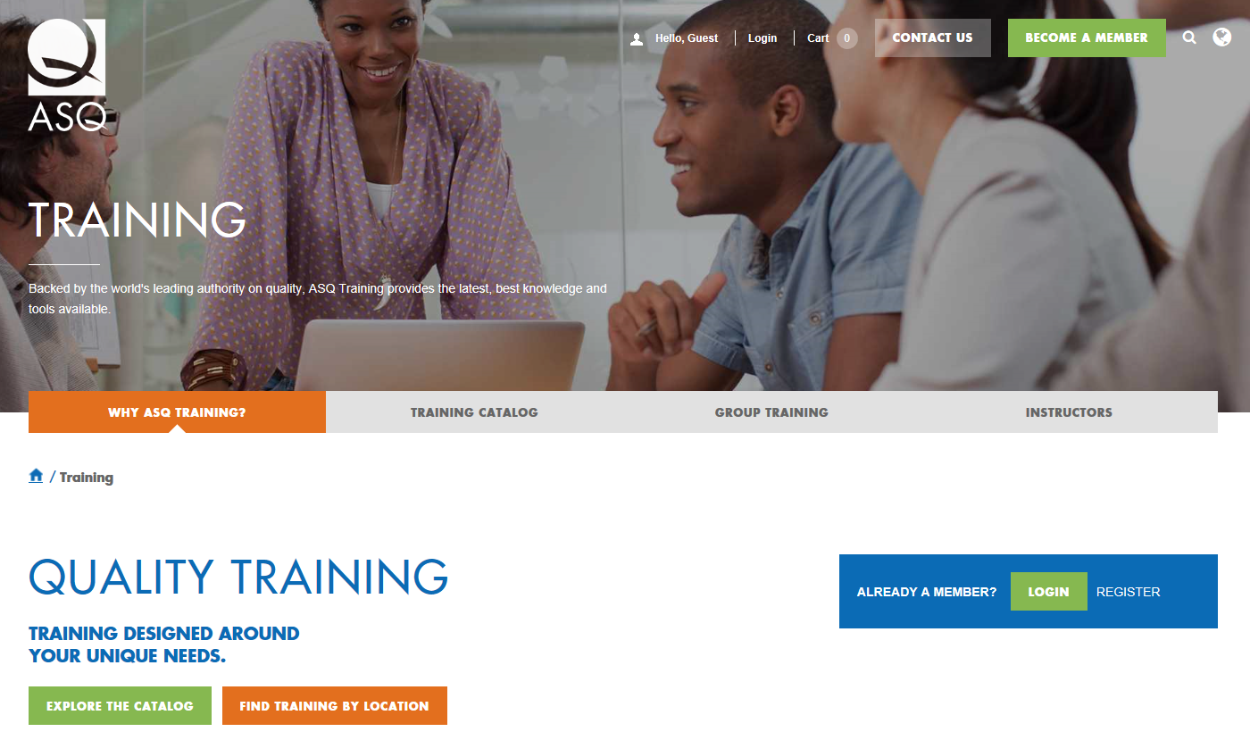
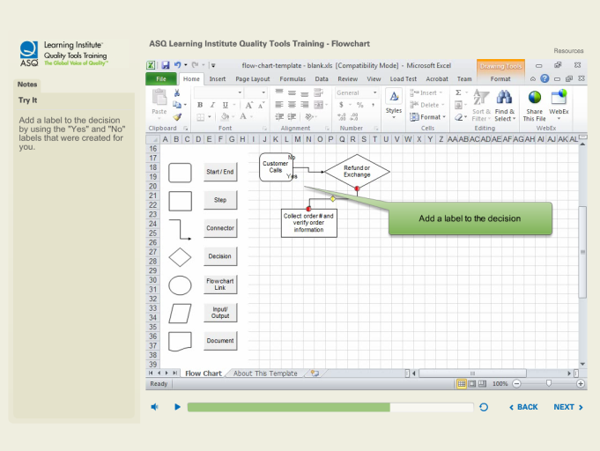
Training: ASQ HQ Offered
Notes:
ASQ offers off-the-shelf and customized training, anywhere in the world, with expert quality practitioners from across a range of industries and experiences and courses designed with every learning style in mind. From courses focused on compliance to best practices, ASQ offers the training experiences that let organizations and individuals gain and apply the knowledge to do more and get a competitive advantage.
ASQ’s Learning Institute equips corporations and organizations with a trusted, comprehensive resource to plan, assess, and execute the quality learning they need to realize their full potential as quality practitioners.
What makes ASQ training different?
ASQ’s training is created by instructional designers/developers and industry experts; then it’s peer-reviewed to achieve the highest level of
accuracy and relevance. Courses are taught by industry experts with an average of 25 years of on-the-job and teaching experience.
ASQ’s subject-matter experts who exhibit the highest level of expertise in their respective disciplines create the course content and develop the training materials.
No matter where your business is located in the world, ASQ can deliver training solutions right to your location.
ASQ’s new Quality Tools/“PDSA & QTools” (pictured here in the slide) are web-based learning products designed to be highly interactive and state of the art self-paced to accelerate learning. PDSA teaches individuals how to apply the tools in each step of the problem solving cycle. The products are designed for companies to deploy across their organization to ensure a common language and process is being used by all. These tools provide a working knowledge for all employees regardless of position –from the novice all the way to a refresher for senior members of a team.

Slide 8
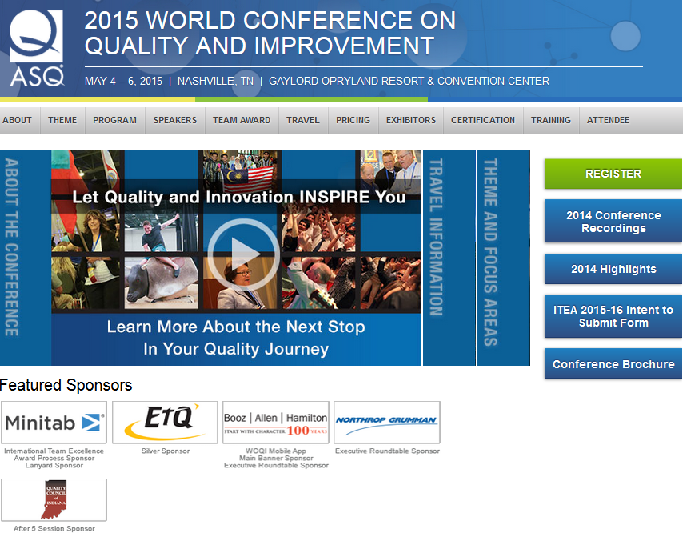
Conferences
World Conference on Quality and Improvement (WCQI)
Division Conferences
  ISO / Audit
  Lean / Six Sigma
  Quality Management
  Many more
Move around the US
  later… Fort Worth – Cowtown Quality Roundup
Notes:
Time isn’t a renewable resource—it’s quick to spend, hard to gain, and it’s one of the most valuable assets of any business or individual. So, every conference better mean business—the investment in time and travel needs to pay dividends in opportunities. Unlike other gatherings, ASQ conferences are events where attendees take inspiration from the connections created between ideas, people, and practices, and turn them into new opportunities to make quality a top priority and key business driver within their own organizations. The connections, inspiration, and knowledge gained from an ASQ conference don’t end on the last day, they continue to connect, inspire, educate, and promote a culture of quality.
World Conference on Quality and Improvement (WCQI)/Lean and Six Sigma Conference/National Quality Education Conference (NQEC).
World Conference on Quality and Improvement (WCQI) – The preeminent conference dedicated to the quality industry. Bringing together thousands of quality professionals in one place for learning, training, and networking, the WCQI featured event of the year for ASQ.
Lean and Six Sigma Conference – Gives its attendees an opportunity to network with others who have "been there and done that," and learn from proven firsthand applications, technical applications, and best practices. The Lean and Six Sigma Conference delivers valuable information for all industries, belt levels, and careers.

Slide 9
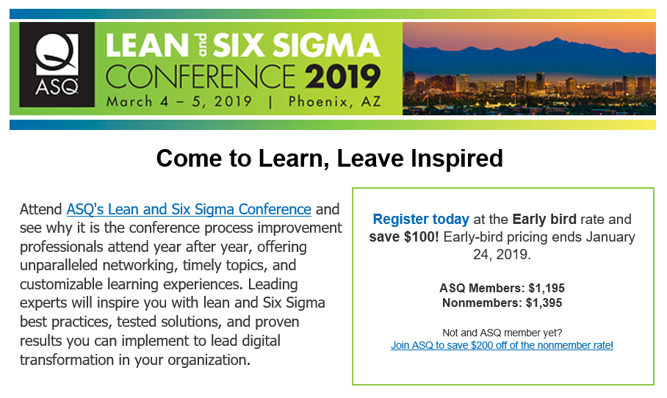
Division Conferences
Notes:
9

Slide 10
ASQ Audit Conference
Sample
When: Friday, Oct 12-13, 2017
Where: Dallas – Intercontinental Hotel
Cost: $895
Theme: “Blueprint for a Successful Audit Program” Acknowledge the Past – Embrace the Present – Prepare for the Future
Overview:
  Successful audit programs do not happen overnight and certainly do not happen without thoughtful planning and execution.
  In order to develop a successful audit program you need a “Blueprint” for the future.
Web site: http://www.asqauditconference.org/
On-Site Exams Sat 10/14
Notes:
10

Slide 11
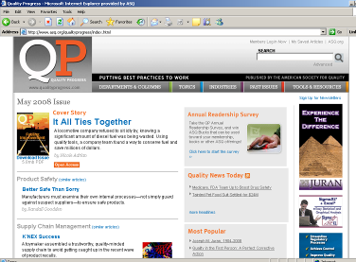
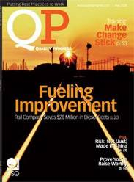
Publications and Media
Quality Progress
Quality Press
Standards
Audiotapes
Webinars, Video
Software
Notes:
3
Quality Progress, ASQ’s flagship publication, is a monthly magazine that contains articles and columns on important, new and emerging quality topics.
Quality Press is the world’s largest publisher of quality-related products, including books and magazines.

Slide 12
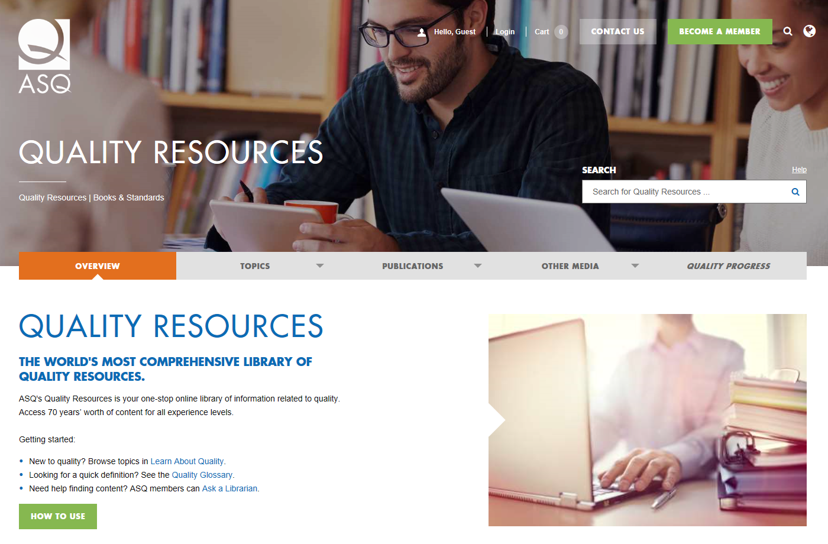
Quality Resources
Notes:
ASQ’s unparalleled quality body of knowledge (QBOK) provides quality professionals with the ideas and tools that will help them meet tomorrow’s critical challenges.
ASQ’s online, and always growing, digital library of all quality knowledge, information and content, and search functions that make it something of the “Google” of Quality, altogether is the ASQ Knowledge Center.
The content is continuously refreshed and updated. It features all formats, all topics and disciplines, it is global in scope, reaches to division Quality Bodies of Knowledge.

Slide 13

ASQ™ TV
Notes:
ASQ™ TV is a tri-weekly online video series that brings to life stories on quality innovation strategies, ideas, and tools to achieve continuous improvement and performance excellence in your organization, community, and our world. You can check out all of the episodes at http://videos.asq.org/home and be sure to keep your eye on the site, as a new episode is released every three weeks. Episodes are available English, Spanish and Mandarin.

Slide 14
Certifications
Fundamentals:
  CQIA – Improvement Associate
Technical… non-renewable:
  CQI – Quality Inspector
  CQT – Quality Technician
  CQPA – Process Analyst
  SSGB – Six Sigma Green Belt
Auditing:
  CQA – Quality Auditor
  CBA – Biomedical Auditor
  CHA – HACCP Safety Auditor
Engineering:
  CQE – Quality Engineer
  CBB – Black Belt – requires project before exam
  CRE – Reliability Engineer
  CSQE – Software Quality Eng
  CCT – Calibration Technician
  CSQP – Supplier Quality Professional
Managerial:
  CMQ – Manager Quality / Org Excellence
Later… Fort Worth:
Conducts Prep Classes

Slide 15
Certification Exam Cycles
Even Months
    Engineer
    Auditor
    Green Belt
    Process Analyst
    Improvement Assoc.
Odd Months
Manager
Black Belt
Reliability
Technician
Supplier Pro.
All exams cycles start on the first Friday of a month and run 17 consecutive days, including Sat & Sun.
Exam Application deadlines are 4 weeks earlier.

Slide 16
Division Membership – Unlimited Access
Industry | General Interest
Electronics and Communication | Human Development & Leadership
Aviation, Space & Defense | Team & Workplace Excellence
Food, Drug & Cosmetics | Product Safety & Liability
Energy & Environmental | Measurement Quality
Design & Construction | Quality Management
Chemical and Process | Customer-Supplier
Service Quality | Lean Enterprises
Government | Inspection
Biomedical | Innovation
Automotive | Six Sigma
Healthcare | Reliability
Education | Statistics
 | Software
 | Audit

Slide 17
Questions about ASQ
Conferences & Training
Web Resources
Certifications
General
Notes:
17

Slide 18



Greater Fort Worth Section 1416
Your First Point of Contact
for all your quality needs
PO Box 161691 Fort Worth, Texas 76161
Vision
To be the area’s leading resource and recognized champion of matters related to quality.
Mission
To serve the needs of our membership and the community by providing a local forum for information exchange, professional support and continuous learning.
Web Page: www.asqfortworth.org

Slide 19


About ASQ 1416
Greater Fort Worth
Section 1416
Service Area: Tarrant and surrounding Counties
ASQ Founded: 1946 Section Charter: 1981
Membership: 590+ Leadership Team: 30+
Professionalism: 318 members hold 587 certifications
Primary Services:
  Monthly Meetings Annual Conference Refresher Classes
  Member Recognition Community Service Free Webinars
ASQ Total Quality Award – annually 11 consecutive years
  Best of 250 Sections for 4 consecutive years
ASQ Excellence Award – Member Sat. Gold – 7 years
    awards discontinued but performance remains

Slide 20
Leadership Committee Functions
Section Chair | Vice Chairs
Treasurer | Secretary
Membership | Education
eNewsletter | Web Systems
Webinars | Placement
Arrangements | Recognition
Conferences | Youth Outreach
Web Page: www.asqfortworth.org

Slide 21
Meeting Feedback
Program / Conference Topics
  From multiple surveys

Slide 22
Sample Programs / Tutorials
Economic Case for Quality
Reliability Models
Measurement/Gage Studies
Software Tutorials
Networking / Workshop
Science Fair Presentations
Conflict Management
Motivational Speakers
Career Management
Failures >> Success
Failure Analysis
Cultural Quality
Six Flags Quality
Benchmarking
Simple Statistics
Audit Hints
Process Auditing
Lean Six Sigma
Risk Analysis
Adult Learning

Slide 23
Tutorial Choices – Pick One
Sample
Specialty: “GD&T”
  ANSI/ASME Y14.5 standard, popularly known as Geometric Dimensioning and Tolerancing (GD&T) is a system for defining and communicating engineering tolerances.
  GD&T brings uniformity, precision, and unambiguous recording of design intent and manufacturing tolerance.
Shift to back room
Stay in this room
General: “Networking 103- The Next Frontier”
  Many of us caught the networking vision, beginning with the basics, connecting with others, making new acquaintances, building our contact lists, and expanding it by social media.
  Now we ask, “How can I maximize my benefit?”
  Session will take us back to the underlying basics of making expansive connections, then forward to maximizing our personal benefit
Notes:
23

Slide 24
Tonight’s Program
Sample
Topic: “Today's Effective Leader:
Shifting from Cop to Coach and Counselor!”
  Organizations with better quality and higher levels of performance make the shift from a culture of compliance to a culture of continuous improvement.
  Learn how to start or sustain this culture change through the proven methods shared in this presentation..
Speaker: Mark Graban, Author, Speaker, Consultant
  Mark is an internationally recognized keynote speaker and blogger.
  Mark is the editor of the anthology Practicing Lean and is current writing a new book, Measures of Success, to be released in 2018
  Mark has a BS in Industrial Engineering from Northwestern University and an MS in Mechanical Eng and an MBA from M.I.T.
Notes:
24

Slide 25
New Certifications
Improve Associate
Yellow Belt
Quality Inspector
Quality Technician
Process Analyst
Green Belt
Quality Auditor
Biomedical Auditor
Food Safety Auditor
Pharmaceutical Pro
Calibration Technician
Quality Engineer
Lean / Black Belt
Software Quality
Reliability Engineer
Supplier Professional
Manager Quality / OE
Master Black Belt
If newly earned certification… not yet recognized…
Stand… Name, Company, Certification

Slide 26
Special Recognition: 100% PDM Attendance
Sample
Perfect Attendance – 10 Meetings
    Victor Harvey
    Rob Chastain
    Teri Blackwell
    Ron Moeller
    Roxanne Pillar
    Jim Conkle
  Close but “No Cigar”… 9 Meetings
  Peter Hoi, Greg Kinnan, Bob Mitchell
Notes:
26

Slide 27
Pre-Pay PDM Meals
We have full capability to accept pre-paid meals
  to plan a vegetarian meal
The cost will be the same as the cash, check or credit “at the door”
A BONUS for pre-paid meals: “Get & Go” CHECK-IN
Link: see recent e-Newsletter or Program Details on webpage
NOTE: problems with the steps of the purchase?
It may be due to having an older Microsoft Internet Explorer version…
upgrade you Microsoft Browser
use Chrome or Foxfire, or a tablet device.
Free Meal
Notes:
27

Slide 28
Certifications / Preparation Classes
CQIA – Improvement Associate – 3 hr basics
CQPA – Process Analyst – 4 hr – math!
CQT – Quality Technician – 4 hr – math!
SSGB – Green Belt – 4 hr – little math
CQA – Quality Auditor – 5 hr w/ case study
CQE – Quality Engineer – 5 hr – math!!
CBB – Black Belt – requires project – 4 hr–math!!
CMQ – Manager Qual/Org Exc – 4 hr – 2 essays
CSQP – Supplier Quality Pro – 4 hr – math?
Most Classes scheduled to start mid-February annually
Web Page: www.asqfortworth.org

Slide 29
Preparation Courses – 1 Season Plan
General Plan
CQE Sat 8 - 12 Feb 20 10 classes $500
CQA Sat 8 - 11 Feb 20 9 classes $500
CSQP Sat 8 - 12 Feb 20 10 classes $500
CQPA Sat 8 - 12 Feb 20 8 classes $350
SSGB Mon 6–9 Feb 22 8 classes $450
CQIA Sat 8 – 5 Mar/May 2 classes $250
CBB Sat 8 - 2 TBD 7 classes $600
CMQ Sat 8 - 1 TBD 8 classes $600
ALL VIRTUAL during COVID
Location: all at Alcon I-35W south / I-20

Slide 30
Cowtown Quality Roundup
When: Friday, April 16, 2021 – 21st Annual
  all day (8:30 – 4:30)
Location: Radisson, Meacham Blvd, Ft Worth
  – near I-35 / N Loop 820
Cost: $147
  Early Bird Discount
Program – 5 tracks – 15 topics – pick 3!
  Compliance Leadership Supplier Management
  Quality Mgt Quality Tools Personal Development
  Keynote to wrap up the day
Notes:
30

Slide 31
Webinars
Day/Date | Time | Topic
Thu 12/03 | 6:00 | Eight The Innovation Management Principles
PDM | 7:20 | Process Behavior Charting – speaker 1
Thu 12/10 | 7:00 | Toying Around with Six Sigma: What’s in the Toybox
Thu 01/07 | 6:00 | Business Continuity
PDM | 7:20 | Elevate Your Career - Growth Strategies
Wed 01/27 | 7:00 | Process Behavior Charts – speaker 2
Thu 02/04 | 6:00 | TBD
PDM | 7:20 | TBD
Wed 04/24 | 7:30 | Management 2.0 for Practitioners and Leadership
Weekly Wed |  | Software / Proj Mgt - lwestfall@westfallteam.com
Web Page: www.asqfortworth.org
and myASQ.org > Greater Ft Worth
Notes:
31

Slide 32
Special Interest Groups (SIG) -- in Dallas
DFW Biomedical Discussion Group
  1st Tuesdays @ Abbott Diagnostics, Irving
ISO / Audit
  2nd Tuesdays @ Abbott Diagnostics, Irving
Lean Six Sigma
  3rd Thursdays @ NEC Corporation, Irving
Food Drug & Cosmetics
  3rd Thursdays @ Mannatech, Coppell
  Shifted to Virtual Sessions
* All start at 6:00 PM *

Slide 33
Help Wanted
General
  Several roles exist (small and large)
  Many don’t require ‘another meeting’
  Work from home or office “per your availability”
  We pay well !
  Jobs earn 1.5 RU per year AND…
  Credits towards Refresher Classes
  Logo Shirts, Food, Recognition

Slide 34
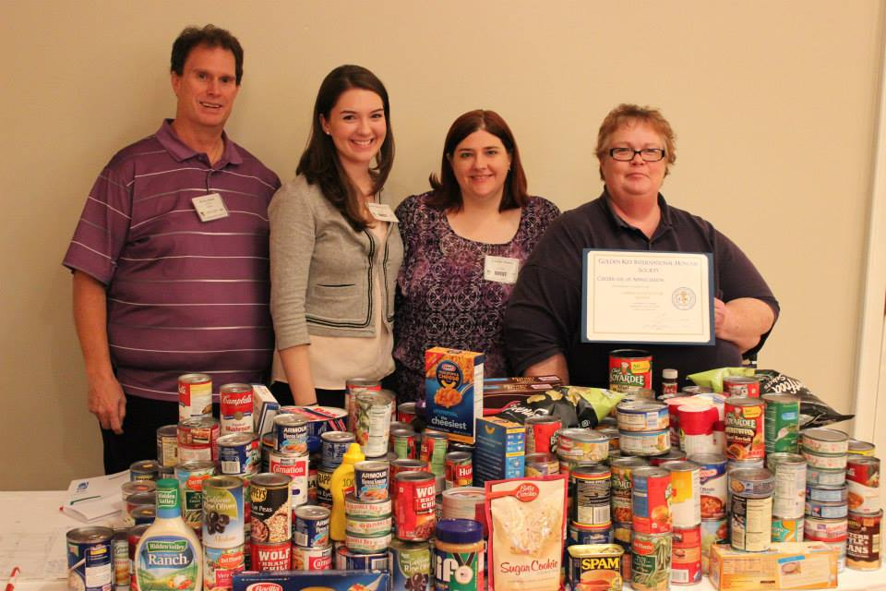



Community Engagement / Outreach
Feb/Apr – Ft Worth Science & Engineering Fair
  ASQ Members judge over 300 projects to ASQ criteria
  “Winners”, family & teachers to April Awards Meeting
Nov – Canned Food Drive
Dec – Toys for Tots with US Marine Corps
Notes:
34

Slide 35
Section Communications
Web Page: www.asqfortworth.org
  Monthly PD Meetings, Education, Contacts, Links
Email Distribution – eNewsletters
  Quality Calendar – 4th week Dated Events, PD Mtg
  Special: 1 more per quarter if needed
  ASQ Weekly – from ASQ (not us)
USPS Mail Postcard
  Meeting Reminder

Slide 36
Is Your Information Correct ?
Are you getting Postcard meeting notices ?
Are you getting eNewsletters?
Update your profile call: 800-248-1946
  www.asq.org - Headquarters' database
  database provides local email distribution list
Our Web Site: www.asqfortworth.org
Notes:
36

Slide 37
Greater Fort Worth Section
Member Value Statement:
Members… our Section’s single most important asset. Your dues yield a very high return on investment through:
  Widely-varied education and training opportunities in a variety of platforms and time commitments
  Monthly Professional Development Meetings
  Networking opportunities with other quality professionals to share knowledge and experiences as well as to participate in activities as socially responsible members of the community where you live and work.
Sustained membership in ASQ ensures your Section will be able to provide opportunities to delight and serve you in your pursuit of continuous growth and development as quality professionals.

Slide 38
Questions Ft Worth Section
Monthly PD Meetings
Certification Classes
Local Opportunities
General Q&A
Notes:
38

Slide 39
Section Calendar
Dec 03 - PD Meeting – continue as webinar delivery
Dec 10 - Webinar – Six Sigma at Santa’s Workshop
Dec 17 - Section Leadership Meeting – virtual
Jan 07 - PD Meeting – continue as webinar delivery
Jan 21 - Section Leadership Meeting – virtual
Jan 27 - Webinar – Process Behavior Charts
Feb 04 - PD Meeting – virtual
Feb 20 - Cert Prep Classes for Jun Exam – all online
Mar 04 - PD Meeting – virtual
Apr 16 - Cowtown Quality Roundup Conference
Notes:
39

Slide 40
Upcoming PD Meetings
Dec 3 – delivered by Webinar
  Topic 1: Eight Innovation Management Principles
  Topic 2: Process Behavior Charting
Jan 7 – delivered by Webinar
  Topic 1: Business Continuity
  Topic 2: Your Career – Growth Strategies
Feb 4 – delivered by Webinar
  Topic 1: TBD
  Topic 2: TBD

Slide 41

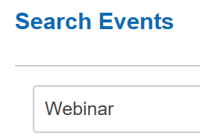
Webinars – Conferences
Date Topic Day Time
Sep 10 Risk-Based Tue 9 am
See most recent eNewsletter for Section Event registration links
Earn 0.1 RU per webinar (hour)
Self Search via
myASQ.org

Slide 42
Classes: Winter 2021 Starts
Exam Window start: JUN--- Application Date: 03-MAY
Class | Day/Time | Fee | Start | Classes - hrs each | Location | Status
CQE | Sat 8 - 12 | $500 | 2/20/21 | 10 classes – 4 hr | Online | TBD
CQA | Sat 8 - 12 | $500 | 2/20/21 | 9 classes – 3 hr | Online | TBD
CSQP | Sat 8 – 12 | $500 | 2/20/21 | 10 classes – 4 hr | Online | TBD
SSGB | Mon 6 - 9 | $450 | 2/22/21 | 8 classes – 3 hr | Online | TBDTBD
CQIA | Sat 8 - 5 | $250 | Mar/May | 2 classes – 7 hr | Online | cancel
$100 Discount if register by Jan 20
Due to the lack of commitments to regularly scheduled classes for CSSBB and CMQ/OE we are taking Pre-Registrations for each and when we receive 5 commitments,
we will schedule the classes - both are 10 weeks and cost $600 before discounts.
For Questions: James Healy at classes@asqfortworth.org
Note: Discounts are available for companies sending 5 or more people, and we may move the class to your location. Scholarships are available for unemployed Section members.
Notes:
42

Slide 43
Final Q&A
ASQ / Resources
Certifications
Education / Classes
PD Meetings
Other
Notes:
43

Slide 44
Web Resources
www.asqfortworth.org
www.myASQ.org
www.ASQ.org
Notes:
44

Slide 45


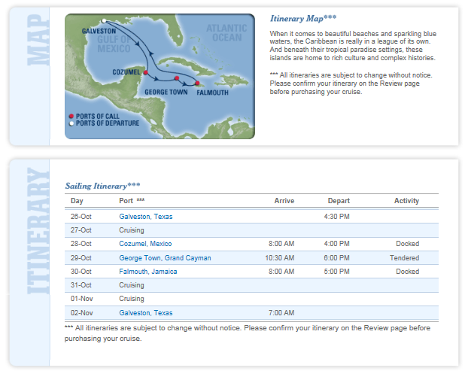
ASQ Cruise – Sep 2019
An all-inclusive price package from $728 per person.
  7-Night, 23 meals, conference fee, port fees & taxes included
  Seminar prices: $728 inside, $828 Ocean View, $1028 Balcony
    Compare to any 3-day conference pricing w/o hotel & meals…
  Non-Seminar price $100 less than seminar prices
Royal Caribbean Line – Port of Galveston
  Sun Sep 08 to Sun Sep 15 – Liberty of the Seas
Program:
  For Personal and Professional Growth
  3 Days – Presentations & Forums (3-6 hr each)
  3 Days – Ashore… tours, beaches, shopping →→
Guests
  Anyone… family, friends, children, co-workers, social groups
  Register: open NOW - website – see Monthly Newsletter
Info: https://s1416.weebly.com/asq-cruise-2019.html
Notes:
45

Slide 46
Quality 4.0 Summit Conference
When: Mon-Tue, Nov 18-19
Where: Dallas Marriott Quorum by the Galleria
Cost: Not yet posted – expect about $1000
Thriving in Disruption:
  To achieve excellence through quality is to embrace the future of quality. It is paramount that quality professionals help their organizations make the vital connection between quality excellence and their ability to thrive in disruption.
  ASQ’s Quality 4.0 Summit will act as the catalyst for professionals, helping them understand how quality will enable transformation and growth.
Web site: http://asq.org/conferences-events.html
Notes:
46

