Slide 1
SAC to GCC
Reenergizing -Optimizing the Member Experience…Update
August 2018
Notes:
Greetings fellow members.
On behalf of the Section Affairs Council (SAC) including our Region Directors and Deputy Region Directors. Thank you for viewing this SAC to GCC Transformation update.
As we have been doing along the way, the purpose of this presentation is to provide as much information as possible to bring you up to date with Transformation, Transition as well as future plans.

Slide 2
Transformation Update
Brief Recap of the ‘WHY’ Transform
Notes:
Our last formal update was in May and we are happy to provide another Transformation update. Some of you may not have seen or heard this information at all.
Before we get into the update and plans, let’s step back and briefly spend a few moments reviewing the ‘WHY’ transform.

Slide 3
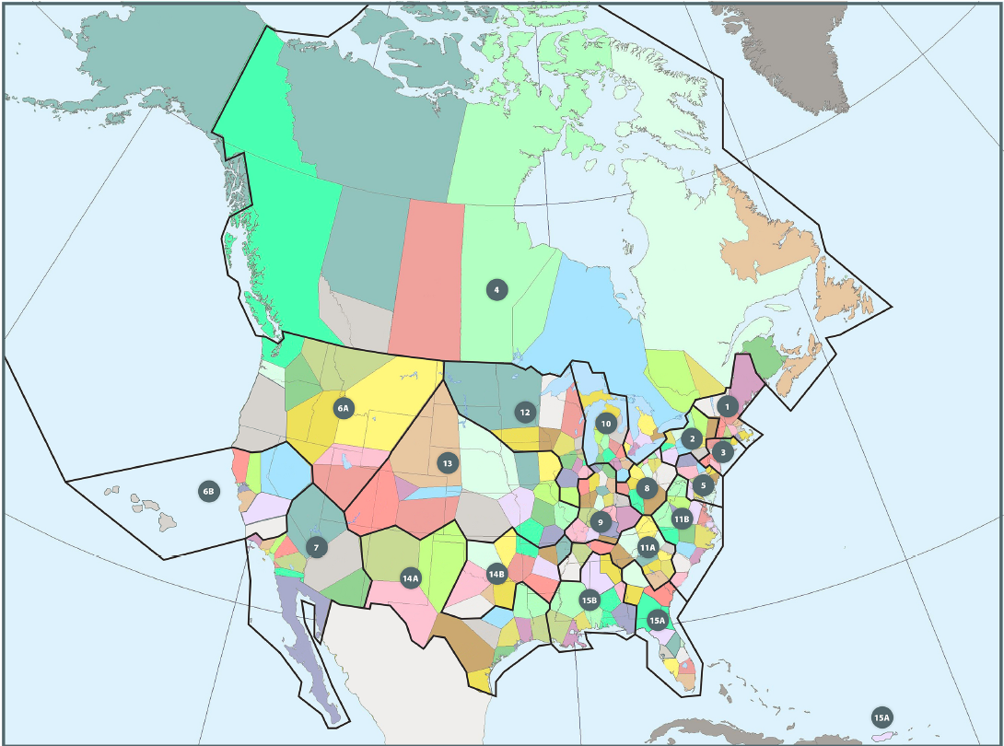
SAC Current Region Structure
Notes:
This is a visual of the current SAC structure which encompasses the United States and Canada.
SAC is currently divided into 19 Regions that are managed by Region Directors.
The borders and boundaries of sections and regions have changed over time since the development of sections depending on membership levels. Section boundaries are determined by zip code. This has resulted in an almost undiscernible set of boundaries that often even the sections themselves often don’t know or understand. Consequently, the region boundaries are similarly undiscernible.

Slide 4
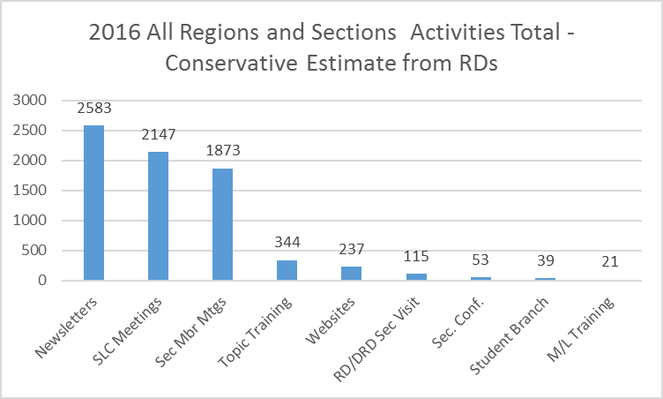
Region and Section Activity – Some of the work…
Regions and Sections – great things we do
Also
Outreach to community including businesses and schools
Chamber of Commerce meetings and presentations
Social Media (Linked in, Yammer, Twitter, Facebook, etc.)
Many networking opportunities collectively and individually
Notes:
Let’s take a moment to review the many great things that our sections accomplish. These numbers are conservative estimates based on considered feedback from regions.
Please take the time to review this data.
You can see from these data that our sections are performing a tremendous service to add member value and service our communities.

Slide 5
SAC Scope and Activity Summary
SAC – Scope of Work and Performance
19 Regions
19 Regional Directors
49 Deputy Regional Directors
234 Sections
Minimum of 1,404 Member/Leaders (~ 6 M/L per Section)
68,923 Members
PAR
    Gold (4)
    Silver (16 - down from 27)
    Bronze (26 – same)
    Honorable Mention (24 – up from 2)
    Innovation (1 – down from 6)
Notes:
This is a little more data to help us understand the number of human resources and amount of energy that is continuously being expelled to service our sections and associated communities.
The Performance and Recognition (PAR) process recognizes those sections that successfully meet their business plan and associated goals.

Slide 6
PAR Performance (evidence that we are struggling)
Notes:
Many of our sections are not even eligible for PAR awards. This pareto clearly shows why our sections are not meeting those requirements. Additionally, failing to meet these requirements threatens the Tax Exempt status that ASQ enjoys today.
The categories are:
Not completing and submitting quarterly financial reports
Not submitting a complete business plan
Not submitting the required slate of officers
Not submitting an annual financial report
Late annual financial report
These are all fairly simple and basic requirements to be in good standing with any organization.
The fact that we see so many sections struggling to meet these basic requirements gives us pause. We must consider the possibility that our Section Leadership Committees are overburdened. Our transformation must take into account ways to minimize the administrative burden associated with section management.

Slide 7
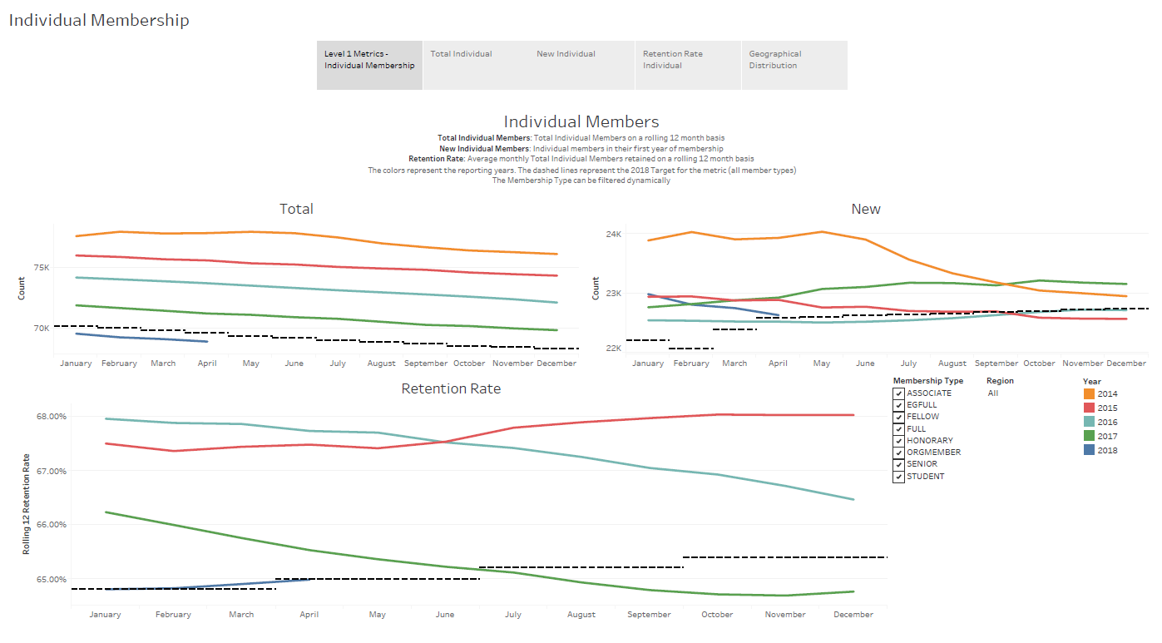
Notes:
Since ASQ’s height in membership of approximately 125,000, we have seen a slow and steady decline in membership.
We have been providing the same basic service and experience through this period of time.
As you can see from these graphical analysis, the decline in total members, new members and member retention continues.

Slide 8
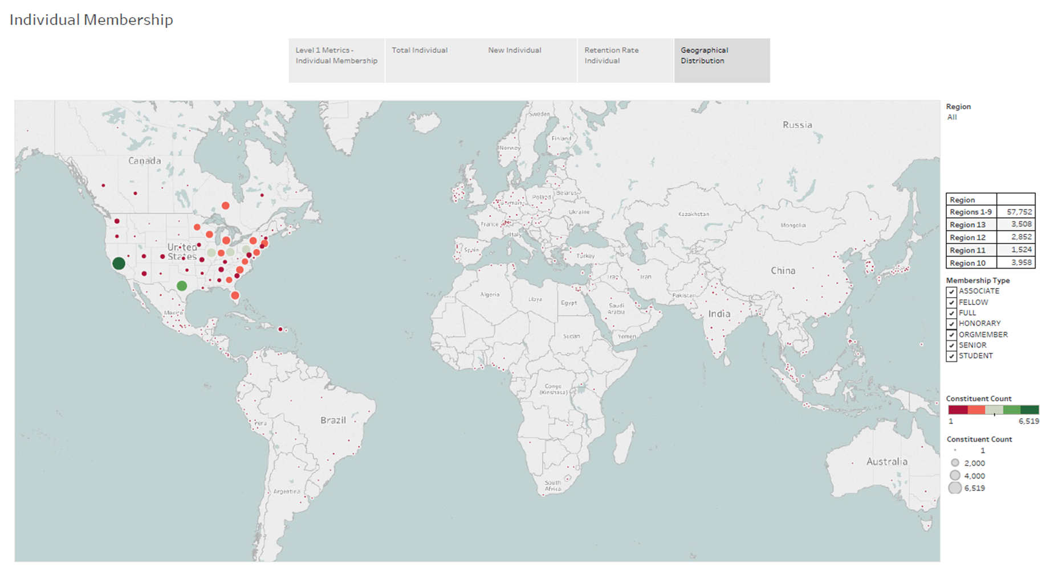
Notes:
This bubble chart is provided as a simple graphic of where our membership is today. The actual numbers are continuously changing and there is a margin of error.
However, this picture makes the reality of our current global membership quite clear. We have a tremendous opportunity for growth.

Slide 9
Current and Target Dissolution and Growth Rates
# Sections
Approximately 2 / year
# Student Branches
# Geographic Communities
Notes:
Today we have a little bit of a good news / bad news story. As to be expected with continuous member decline, under our current structure we are losing approximately 2 sections per year.
As we lose sections and geographic area, the effected members are absorbed into surrounding sections. Subsequently, the current region and section map continues to change.
The good news is that we are seeing growth in our student branches. The challenge with our current structure is that there must be a strong viable section nearby for the Student Branches. We have addressed that with the new GCC structure that you will see later in this presentation.

Slide 10
The Changing Culture of the World Around Us
We must consider in our planning

Slide 11






Special Challenges – The Environment we ARE in!! – World is Changing
Competing Priorities
Information Technology
Peloton
Tesla / Dominos Pizza
This Photo by Unknown Author is licensed under CC BY-NC-ND
Notes:
Another thing to consider as we think about what we may need to do differently is the changing world and its effect on the things we typically do.
We need to remember that our member/leaders are volunteers that have many priorities. (God, Family, Work and Career, hobbies…then ASQ.
We live in a world where folks want things at their fingertips. Information is there and we don’t need to travel to a meeting to get it.
Peloton example – what is unique about he Peloton approach is not as much the equipment as that customers are provided on line interactive workout sessions with the instructors of their choice. Customers don’t even need to leave their home to workout.
Tesla and Dominos have teamed up to have driverless pizza delivery. While innovative, the feedback from customers included dissatisfaction they had to leave their home or apartment and walk to the car to get the pizza.
The bottom line…we need to find ways to reach out and go to our members and communities.

Slide 12
Our approach to tacking the issues
Transformation Approach:
Development of Member Led Committees

Slide 13
Committees to meet Transformation Transition Goals
SAC / transition / GCC
Sections
TCC
HQ / CD
Org Members
Global Members
Board of Directors
Communication
Barrie Simpson
Funding/Finance
Jim Creiman
Technology
Don Brecken
GC Structure
Luis Morales.
Documentation
Jim Kittredge
Governance Business Mgt
Bud Newton
Notes:
Beginning in fall 2017, we worked with various RDs and formed 5 committees to help bring a “straw man” to life as we worked to structure the approach and associated resolution.
As you can see this is, very much, a member led initiative with committees and teams reaching out to members and member/leaders for input. Our committee leads must reach out to all areas within the society for input and guidance. Of course, this committee work is regularly reported to the Board of Directors for feedback and guidance.
All of these committees and associated teams and sub-committees will continue their work through our upcoming transition.

Slide 14
ASQ Transformation Update
Notes:
Briefly mention the 2018 business plan. Read the tech committee objectives.

Slide 15
The Goal
Expanding and Optimizing Service to Membership to Increase Member Value

Slide 16
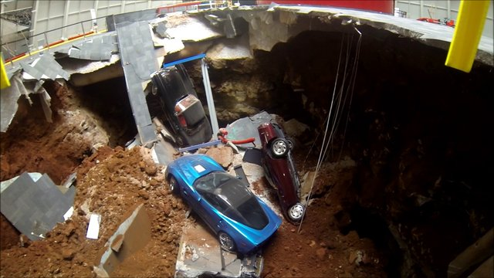
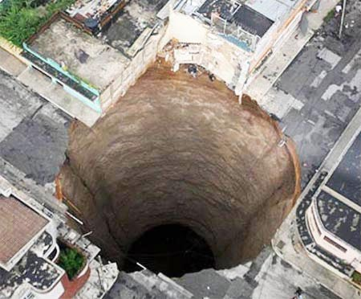
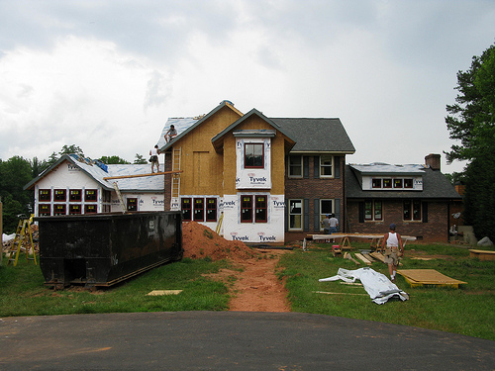
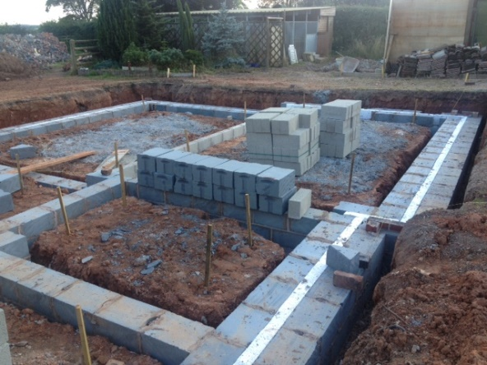
Transformation – what is really going on?
Not This…
Members, Geographic Communities
Remodel/Restructure Framework to best support
Rather…This
Notes:
Contrary to what a few might be saying…we are not pulling the rug out from under our geographic communities (sections, etc. ) Transformation will not create a giant sinkhole that will swallow up our sections and other geographic communities. As you will see from our resolution, our geographic community approach is expanding to a global solution.
With Transformation, we are taking a hard look at our current structure all the way to the foundation level. We are looking to optimize the individual member experience and more fully align with all of the Societies stated efforts and strategic plan.
With the global initiative, our framework will expand.
The objective is the development of a sustainable framework and system (good times and bad). This is a framework that focuses on delivering member value.
We define ‘Member Value’ as:
Value received from being a member
Value of our members to the communities they serve

Slide 17
Expansion/Integration of Service to Members, Community and the World
Service
Service
Service
Service
Service
Centralized Administration
Service
Service
Service
Service
Service
Service
Service
Notes:
We (SAC) have been using member, member leader, and non-member data to determine what transformation would need to look like to better support our members, sections and respective communities.
The solution must address two main considerations:
Centralized Administration (this removes some of the burden on volunteer member/leaders)
De-centralized, flexible and innovative diverse Service (allow member/leaders to focus on the services that our members and communities require)

Slide 18
What have we done so far?
What does the future look like?

Slide 19
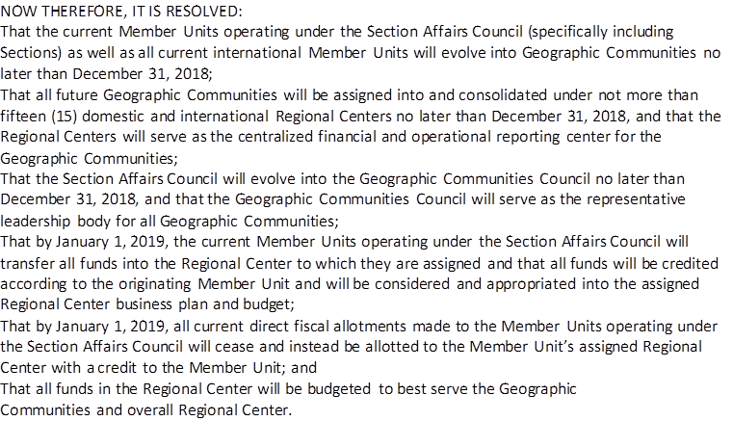
SAC to GCC Resolution
Notes:
After careful consideration, data analysis, and review with member/leaders at all levels SAC worked together and crafted the resolution above. SAC approved this resolution early February, 2018. This resolution was then presented to the ASQ Board of Directors (BoD) and approved late February 2018.
As a result, the Section Affairs Council (SAC), currently covering only North America, will become a global Geographic Communities Council (GCC). Member units around the globe will be absorbed into the GCC as member led geographic communities within clearly defined global regions.
The Region Centers (RC) will become the focal point for region growth, member and community service. Representatives from within these global regions will be elected by members to govern their respective regions.
In March, SAC approved a standard communication that was presented in a PowerPoint format to Section Leaders to be shared with their respective membership.
As communicated then and now, the ‘section’ approach is alive, well and part of our future.

Slide 20
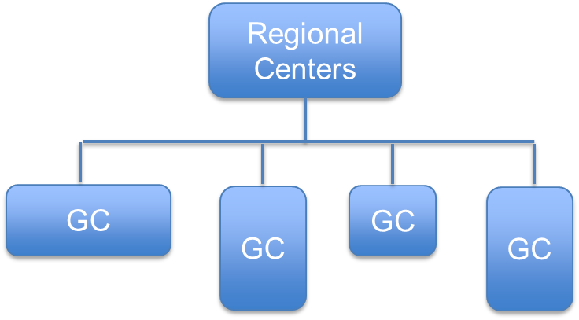
Region Centers and Geographical Community Council (GCC)
ASQ (Members, BoD)
GCC
Notes:
Here is a graphic of the afore mentioned resolution in place.
ASQ’s BoD continues to be the focal point of governance and sets the direction of the Society including Headquarters, GCC, and TCC, et.al..
The Geographic Communities Council (GCC) provides the governance over the 13 new Regions.
The Regions provide the governance and direction for their respective Geographic Communities.
The following slides will provide more detail helping to better define these organizations and their relationships.

Slide 21
The Structure
Geographic Community Council
Region Centers
Geographic Communities

Slide 22





Geographic Community Council
Geographic Community Council:
Surveys Membership, Regions, Communities
Supports Global RC Strategies and Business Plans
Financial Oversight of RCs and GCs
Monitors Performance and Progress
Reports Status and Results
Governance of RCs and GCs
Elects BoD Representatives (6)
RDs are voting member
DRDs are not voting members
Resource Manager and Coordinator are not voting members
C. O. Mgr.
(shared)
Region
Director
Region
Director
Region
Director
RD
GCC
Chair
RD
GCC
Vice - Chair
Region
Director
Region
Director
C. O. Cord.
(Shared)
Region
Director
Notes:
The Geographic Community Council (GCC) will provide oversight, governance and apply strategic thinking and direction related to the functionality of our Geographic Communities around the globe.
The GCC will be made up of 13 Region Directors (RDs) who are voting members representing the globe. There is a position description for RDs.
Additionally GCC will include the Deputy Region Directors (DRDs) appointed within each Region. DRD is a non-voting position at the GCC. There is a position description for DRDs
We will discuss the roles and positions in a little more detail when we review the Regions and Region Center approach.

Slide 23
Regional Centers and Geographical Communities (GCs)
Geographic Community Council (GCC) Lead Team:
Surveys Membership, Communities, RCs, GCs
World Picture Strategic Planning – Continuous Improvement
Governance of RCs
Monitors Performance and Progress of RCs
Report to Board of Directors
GC Type 1 (Section, Chapter, Student Branch)
Lead Team
Regional Center (RC) Lead Team:
Surveys Membership, Communities, GCs
Develops Region Business Plan
Manages Finances
Monitors Performance and Progress
Reports Status and Results
Governance of GCs
GC Type 2 (Project Team/Group)
Project Team Leader
GC Type 3 (Focus Team/Group)
Focus Team Leader
Geographic Community (GC) Lead Team:
Survey Membership and Community
Develop GC Strategy and Tactical Plans
Submit plans and needs to Regional Center for approval
Execute plans
Report Status and Results
Notes:
Here we see a little more detail related to the overall GCC structure which is in many ways similar to the SAC structure we have today. Here are some things to consider.
Regions will be managed through virtual Region Centers.
Sections will be managed much the same way that they are today.
With the Region Center approach, it will be easier to form and manage Student Branches and Chapters (formerly known as sub-sections). Student Branches and Chapters will no longer require a strong viable section in the area to form as they will be directly sponsored by the Region Center.
Two new types of Geographic Communities are the Project Team/Group and the Focus Team/Group.
We will cover each of these in more detail over the next few slides.

Slide 24
Region Center Management and Function…
Regional Center Lead Team:
Surveys Membership, Communities, GCs
Marketing/Advertising
Develops Region Strategy and Business Plan
Manages Finances
Monitors Performance and Progress
Reports Status and Results
Governance of GCs within Region
Audit RC and GCs
Region Center Space (Virtual)
Region
Director
C. O. Mgr.
(shared)
Deputy
Region
Director
Deputy
Region
Director
C. O. Cord.
(shared)
Deputy
Region
Director
Deputy
Region
Director
…
Notes:
Let’s first look at the Region Center (RC)
The Region Center will be managed by an elected Region Director (RD) who resides within that Region. The RD will be assisted by appointed Deputy Region Directors (DRDs). Guidelines have been put in place to assure the DRDs are physically located so that there is fair and diverse representation of members and communities within the entire Region. Additionally, paid staff will be assigned to support each Region and the Geographic Communities within the Region.
The RD will be focused on the health of the Region and strategy for continuous improvement.
The RD will work closely with DRDs who will be focused on the service and support of GCs within their assigned areas.
The greatest difference will be the location of funds. Funds will be virtually located at the Region Center and credited to the respective Geographic Community (GC).
This will require each Region Center to develop its own business plan and budget. This budget will be developed respecting the needs of the GCs within the Region.
As is true today, all GCs will be expected to submit a business plan or charter including a budget.
Funds, expenses, credits, special accounts, etc. will be easily accessed and monitored with on line banking methods.
All levels will be subject to internal and 3rd party audit and review.

Slide 25
Geographic Community Structure Model
Regional Centers
Sections
Chapters Student Branches
(SBs)
Projects
Focus
Notes:
The Regional Centers (RCs) are virtual. The regional centers will be member led and governed with assigned Headquarter staff support. Work within a region will be reviewed and approved at the region level. The size of a our new regions will expand significantly as a collection of the current regions that exist today. This affords the opportunity for more global thinking as we manage our work.
Each region will be made up of multiple Geographic Communities (GCs). The types of GCs will vary. Sections will be one type of geographic community. Chapters and Student Branches will no longer be tied to a section as they will have direct ties to the Region Center.
While sections will continue to be a viable and important part of the ASQ experience, the RCs will be the hub for business planning and budgeting. Staff working at the region level will bare much of the administrative burden required of sections today. This will afford member/leaders more time to serve their respective members and communities as they promote the Quality principles and concepts.
This structure will afford the formation of various types of geographic communities. All of these will be managed from the region level.
Let’s now look at the various Geographic Communities in more detail.

Slide 26


Geographic Community (Section)
Section Lead Team:
Survey Membership and Community
Develop GC Strategy and Tactical Plans
Submit plans and needs to Regional Center for approval
Execute plans
Report Status and Results
Secretary
Chair
Vice-Chair
Treasurer
Position
Chair
Position
Chair
….
Notes:
How about the future Sections? Pretty much the same as today.
Sections will still be required to submit an Annual Business Plan and Budget.
Sections will continue to elect representatives to the Section Leadership Committee (SLC)
The greatest difference will the location of section related funds.
Our current practice places the society and its tax exempt status at great risk.
Today we have funds for over 230 sections located in several hundred bank accounts around the globe. This has been the practice since the mid-1900s. We want to take advantage of technological advancements in banking. All funds will be centralized. GC funds (like sections) will be credited and accessed with on-line banking methods.
A significant amount of the current section treasure responsibilities and administrative tasks will be transferred to the Region Center. For the foreseeable future, Section will have a treasurer role. Sections should have someone with their eyes on the section funding and finance. Again, the administrative burden will be greatly reduced.
The 3rd party audit requirements will primarily be focused on the Region Centers with sampling of GCs. Best practice is to do some form of auditing at every level.

Slide 27
Geographic Community
(Chapter or Student Branch )
Chapter or SB Lead Team:
Survey Membership and Community
Develop Strategy and Tactical Plans
Submit plans and needs to Regional Center for approval
Execute plans
Report Status and Results
Secretary
/
Treasurer
Chair
Student
Branch
Liaison
Notes:
Leaders for Student Branches and Chapters will need to be selected.
We will be using similar guidelines as we have today for Student Branches and Sub-Sections (Chapters)
Chapters and Student Branches will still be required to submit a simple Business Plan with Budget for funding.
Chapters and Student Branches will be connected directly with the Region Center.
This helps with the current restrictive requirement that a strong and viable section exists in the area. Chapters and Student Branches are encouraged to partner with local sections as they work to serve their respective communities.

Slide 28
Geographic Community (Project Team/Group)
Project Team:
Determine Project Scope
Develop Charter
Submit Charter to Regional Center for approval
Execute plans
Report Status and Results
Project
Leader
Team
Member
Team
Member
….
Notes:
A team leader will be selected. Team members will be selected.
Example of a geographic community type to help sections, regions and overall society with multiple types of project work in the interest of continuous improvement.
Example Projects:
Develop a 2 year conference plan for a state or region
Logistics for a state or region level conference
Develop a training curriculum to meet identified needs.
The Project Team Leader will be required to submit a Charter and Budget for funding.

Slide 29
Geographic Community (Focus Team/Group)
Focus Team:
Determine Scope of Focus Work
Develop Action Plans
Submit Action Plans to Regional Center for approval
Execute plans
Report Status and Results
Team
Leader
Team
Member
Team
Member
….
Notes:
A team leader will be selected. Team members will be selected.
Example of a geographic community type to help sections, regions and overall society with multiple types of focused work in the interest of discovery and research
Example Focus Groups:
Determine training needs for a state or region
Fellow’s Focus Group
Determine % of organization types within the region by state or within a state by section or county. (i.e. % Health Care, % Manufacturing, % Construction, % Education, etc.)
Determine repetitive quality issues experienced within these
The Focus Team Leader will be required to submit a Charter and Budget for funding.

Slide 30

Region and Section Activity – Some of the work…
Regions and Sections – great things we do
What Else?
New and different?
Something Members can get no other way?
Also
Outreach to community including businesses and schools
Chamber of Commerce meetings and presentations
Social Media (Linked in, Yammer, Twitter, Facebook, etc.)
Many networking opportunities collectively and individually
Notes:
Here is a great example of what we could do with a series of focus groups/teams as part of a GCC global effort!
Yes, our geographic communities do a lot of good things, often in a personal way that is indeed satisfying.
However, the data tells us that many simply want to get the training, credits, conference experience virtually. Many wont take the extra hours out of their life to make a face to face meeting.
We can try to force them to come to a section meeting but ‘good luck with that’.
So we have the question before us…
What service, experience, value added activities can our geographic communities provide that can be done in no other way?
We look forward to working with you to take this one on

Slide 31
2019 RD Assignment and Election
Notes:
SAC has recently voted and approved the plan for RD Election and Appointment for GCC 2019.
Please consider the following information.

Slide 32
SAC Current Region Structure
Notes:
This is our current state. As a review, this is a morphology since the 1940s as the society grew to its all time high membership level of 125,000.

Slide 33

Geographic Community Council Region Map (US and Canada)
Notes:
Per our resolution and subsequent voting, SAC has voted the following regions and region boundaries in place. This shows the 9 US region and part of the new 10th Region Canada and Greenland.
Regions were defined by geographic boundaries much less likely to change and to better represent current condition as well as potential growth. Region size will increase. The number of Regions in north America will be reduced from 19 to 10.
An additional 3 regions have been determined to cover the remainder of the globe based and current membership. As global membership grows, there is a possibility for further dividing into an additional 2 regions for a total of 15 regions around the globe.
We are excited to see the North American SAC approach become the new Global GCC approach.

Slide 34
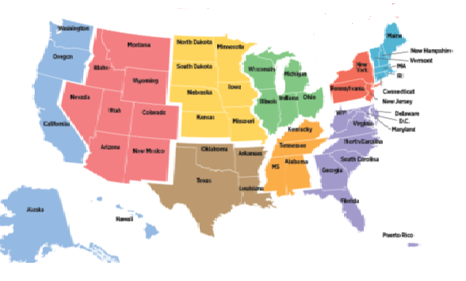
Geographic Community Council Region Map (US and Canada)
2019 Region |  |  | 2019 Director
Proposal for 2019 RD assignments
2019 Region | # GCs | # Members | 2019 Director
(1) North Atlantic | 16 | 4482 | John Conner
(2) Middle Atlantic | 24 | 7270 | Jim Kittredge
(3) South Atlantic | 41 | 11367 | Luis Morales
(4) East South Central | 19 | 2971 | Kaushik Mallik
(5) West South Central | 22 | 5428 | election
(6) East North Central | 48 | 13203 | Bud Newton
(7) West North Central | 11 | 4611 | Lawrence Mossman
(8) Mountain | 13 | 3329 | election
(9) Pacific | 24 | 8798 | C.G. Mistry
(10) Canada, Greenland | 15 | 4231 | election
(11) Mexico, Central and South America |  | 1594 | election/appointment
(12) Europe, Middle East, and Africa |  | 2973 | election/appointment
(13) Russia, Asia, India, Austrailia and New Zealand |  | 3629 | election/appointment
Please…nobody leaves
Notes:
Taking full advantage of the leadership we have in place, in July 2018 SAC has approved this plan for RD election and appointment.
This plan honors the current even number elected RDs who’s term ends in 2018 and the current odd number elected RDs who have one more year of their term. Three of these odd number RDs also currently serve on the Board of Directors (BoD) and will complete that their assigned term in 2019. Similarly the 3 BoD even RD representative’s BoD term ends in 2018.
With this approach, region membership will be electing or appointing 6 new RDs to complete a slate of 13 total RDs. From this pool of 13 RDs, GCC will be electing 3 new representatives to the BoD.
As important, if not more so, is the need to keep a level of stability within this level of member leadership as we transition the later part of 2018 and through GCC’s first year 2019.
Please keep in mind that all RDs have the opportunity to continue to serve as Deputy Region Directors. As previously mentioned, the GCC DRD function is similar to the RD function of today.

Slide 35
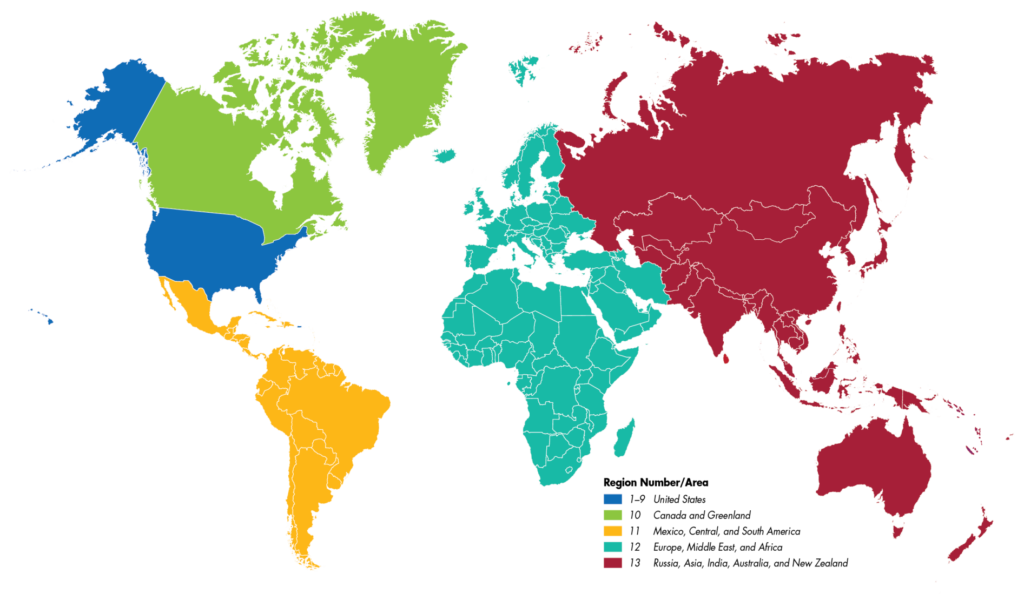
Geographic Community Council Region Map (3 New Regions)
(1 - 9) United States | 233 | 73886 | election/appointment
(10) Canada, Greenland | 15 | 4231 | election
(11) Mexico, Central and South America | Tbd | 1594 | election/appointment
(12) Europe, Middle East, and Africa |  | 2973 | election/appointment
(13) Russia, Asia, India, Austrailia and New Zealand |  | 3629 | election/appointment
Notes:
Now let’s look at the plan related to the full global scope of the new GCC.
Per our resolution and subsequent votes, SAC has voted the following 3 new regions.
Also, the SAC-GCC Governance and Business Management Committee is made up of representatives from outside the US and Canada. Their input was strongly considered as the SAC-GCC formed the 3 new regions.
Elections or appointments of new RDs will be necessary in all 3 of these regions.
DRDs will be appointed and the respective virtual Region Centers will be established.
It is unclear at this time how many of the member communities that exist today within these regions will quality as Sections. Many may begin as chapters that have the opportunity to grow into a full section.
For those regions where needed, the RD nomination and election process is underway.

Slide 36
What is next?
We are moving forward…communication

Slide 37
Transformation Project Plan (high level detail)
Notes:
Please review the plan detail.
This is a simple, high level Gantt Chart for the Transformation Project. There are additional more detailed action plans, specific to committee work, we are working to and tracking progress.

Slide 38
SAC/Geographic Communities Funds/Finance Update
Kick-off meeting between on-line banking tool subcontractor and myASQ Finance Team on July 31
From Sept – Dec 2018, planning tool development and demonstrations for review by member leader stakeholders from three US sections, one Canadian section, two divisions and Latin America
Current project plan has initial hands-on evaluation by the pilot group in December 2018
Sections should expect complete roll-out of myASQ Finance tool in 2019
Until a viable tool is available, continue to follow current section financial practices
Sections’ 2019 Business Planning and Budget are due September 30, 2018
  Use this link to the 2019 Geographic Communities’ Business Planning and Budget template
  Email section business plan and budget to CommunityDevelopment@asq.org and your current Regional Director
Notes:
Sections are currently required to provide to ASQ Headquarters quarterly financial reports and an annual audited financial report. These reports will continue to be required at the Region Center level. To support the new structure, annual business plans and budgets are proposed to be submitted to the regional center in Sept with regional center level approval by November. Regional centers would then arrange section access to funds for its activities by January 1.
With the roll-out of an online tool, Regional Centers and Headquarters will be able to generate the reports they need. Sections would no longer need to submit quarterly reports and an annual financial report. The online banking tool will also provide current visibility for financial expenditures, receipts and fund balances credited to each geographic community.
Our 230 sections currently have about 500 accounts with numerous financial institutions. This move will considerably consolidate and simplify management of these funds. The ASQ Reserve Fund is a conservatively managed investment fund that balances risk and return – it has served well for Headquarters’ and several sections’ and divisions’ reserves for over a decade.
As the online banking tool rolls out and is tested by an increasing number of member units, sections will gradually transition remaining financial accounts and operate through their online bank account. For 2019, all geographic communities should plan to operate with a transition to using the online banking tool.

Slide 39
Documentation Committee
Board approved Document management structure including
  Governance document review by Bylaws Committee
  Policy, Procedure and Work Instruction Template with work instructions for use.
Board approved document authorities empowering GCC to control all procedures and work instructions required for geographic communities functions.
Board retains existing authorities for Bylaws not controlled by membership and all ASQ Policy documents.
Templates and instructions for use were provided to SAC/GCC team leads.
Documents to be approved by SAC/GCC before submission to Bylaws review.
Documents will be posted for SAC/GCC prior to approval requests to facilitate RD reviews.
Notes:
A new documentation process and structure was approved during the August 16, 2018 Board of Directors meeting.
Standard templates are provided and this outlines the current process since the vote.

Slide 40
Best Communication Method at this time…
Ask your RD…
We are moving quickly.
Your RD will have the most up to date information related to section management efforts.
Your RD is closely involved in the decision making process.
Your RD will take your concerns back to SAC-GCC.
Notes:
We are making great progress. We are listening to your concerns as we make decisions. Please continue to reach out to your Region Director for clarification and to provide feedback.
Our 3 new regions are now nominating and electing their respective RDs so they may have the same structure for communication.
Please read the slide.

Slide 41
SAC to GCC
A solid transformation…
to expand and grow individual membership globally
to increase member value.
Thank you
for your support as we progress
for your feedback
for voicing your concerns
for your improvement suggestions

